Slide 1
DATA ANALYSIS AND BUSINESS MANAGEMENT PROJECT
Under the guidance of
Dr. Talha A. Khan
University of Europe for Applied Sciences
Mr. E. George
Avron Global Ltd

Slide 2
Group 08
Athul Krishna Koottalaparambil Silajan
Jose Xavier

Slide 3

INTRODUCTION
XRP is a digital asset and cryptocurrency designed by Ripple Labs, aimed at revolutionizing global payments with its fast and cost-effective cross-border transactions
It operates on a decentralized ledger, offering real-time settlements and low transaction fees for users.
Prices in the XRP market fluctuates due to number of variables, including legislative changes, financial institutions' acceptance, and general market sentiment.
So, an in-depth market analysis is to be done before investing in XRP or any other crypto currency.

Slide 4
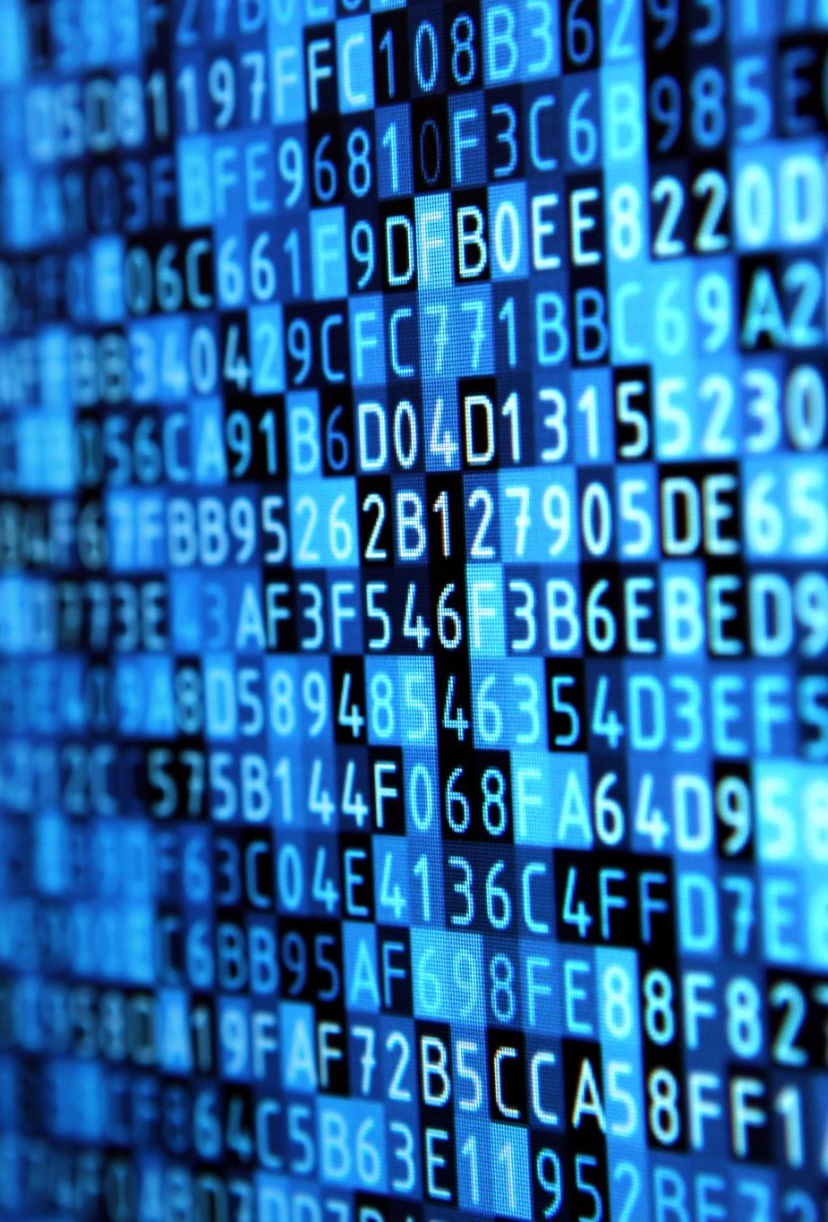
Dataset
Dataset is taken from Binance market data. https://data.binance.vision/?prefix=data/spot/monthly/klines/XRPUSDT/1d/
Dataset contains 16 files from January 2022 to April 2023.
The 16 files are combined into one to get the complete dataset into a single file.
The combined data contains 485 rows and 13 attributes.

Slide 5
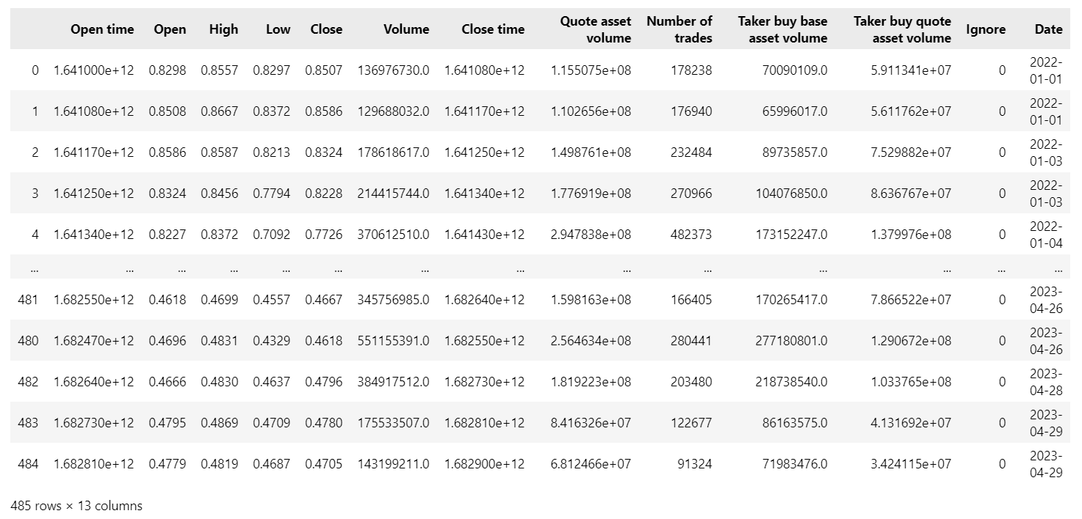
Dataset

Slide 6
What each term means ?
Open time- Timestamp or time when a particular trading event or data point occurs.
Open- Price of the cryptocurrency at the start of the time interval.
High- Highest price reached by the cryptocurrency in the time interval.
Low- Lowest price reached by the cryptocurrency in the time interval.
Close- Price of the cryptocurrency at the start of the time interval.
Volume- Total amount or quantity of cryptocurrency traded during the time interval.
Close time- Timestamp or time when a particular trading event or data point concludes.
Quote asset volume- The total trading volume of the cryptocurrency expressed in terms of the quote asset (the asset being traded against, such as USD or BTC).
Number of Trades: The total number of trades executed during the time interval.
Taker buy base asset volume-. The total volume of the cryptocurrency bought by takers (traders who remove liquidity from the order book by placing market orders).
Taker buy quote asset volume- The total volume of the quote asset (e.g., USD or BTC) used for buying the cryptocurrency by takers.

Slide 7
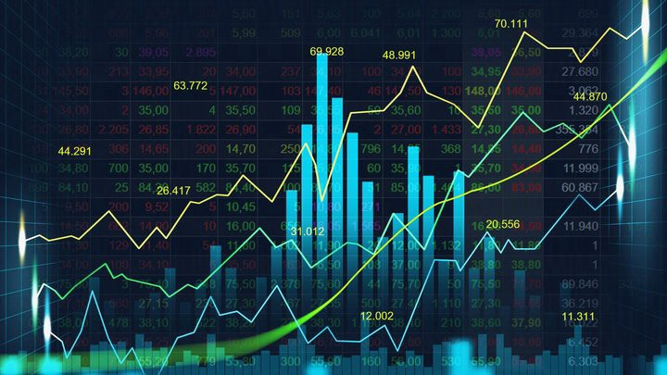
Descriptive analysis

Slide 8

Descriptive Analysis help to understand the basic characteristics, patterns, and trends from the dataset.
Measures of central tendency:- Mean, Median, Mode
Measures of Dispersion:- Range, Variance, Standard Deviation
Frequency Distribution
Quarterly Analysis

Slide 9
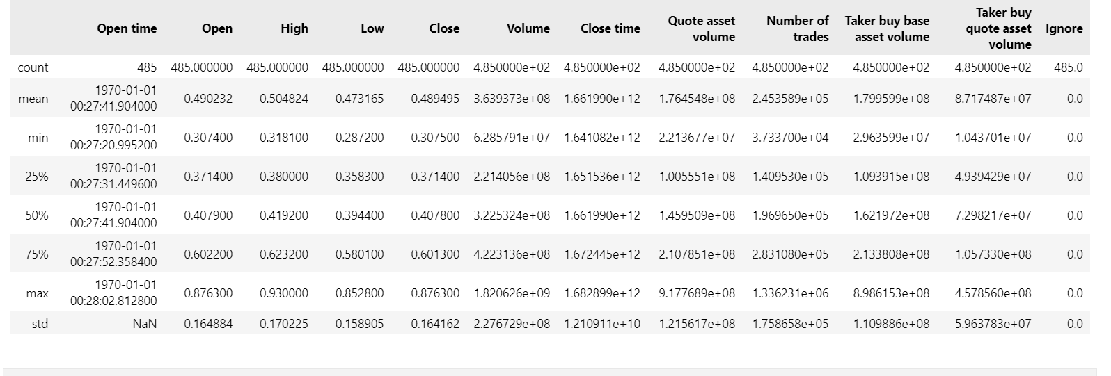

Slide 10
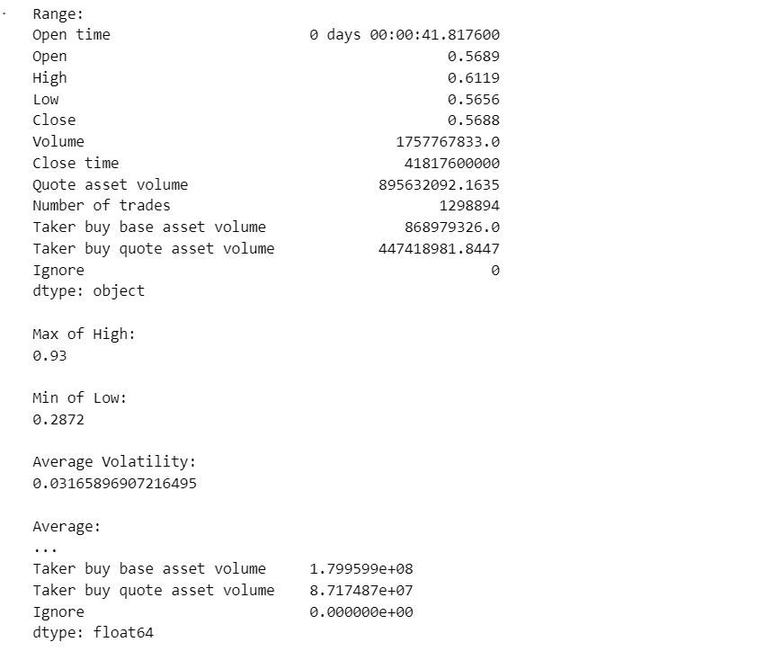
Additional analysis

Slide 11
Relative Strength Index (Rsi)
The RSI is used to measure the speed and change of price movements and helps traders identify potential overbought or oversold conditions in an asset.
RSI is calculated based on the ratio of the average of upward price movements to the average of downward price movements over a specified period, typically 14 periods.
The RSI value ranges from 0 to 100. Values above 70 are considered overbought, while values below 30 are considered oversold.

Slide 12
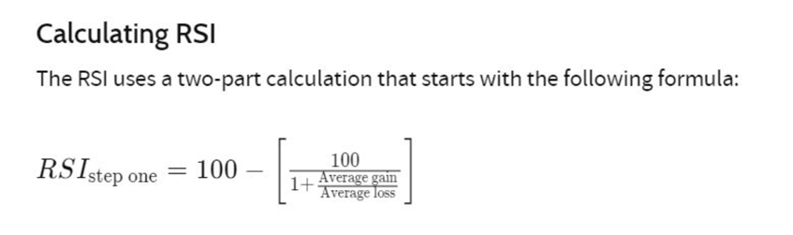

Slide 13
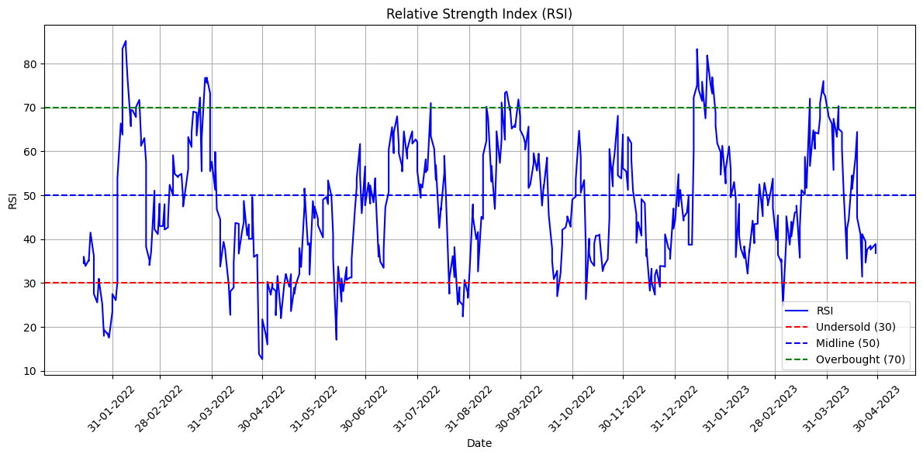
Relative Strength Index (Rsi)

Slide 14
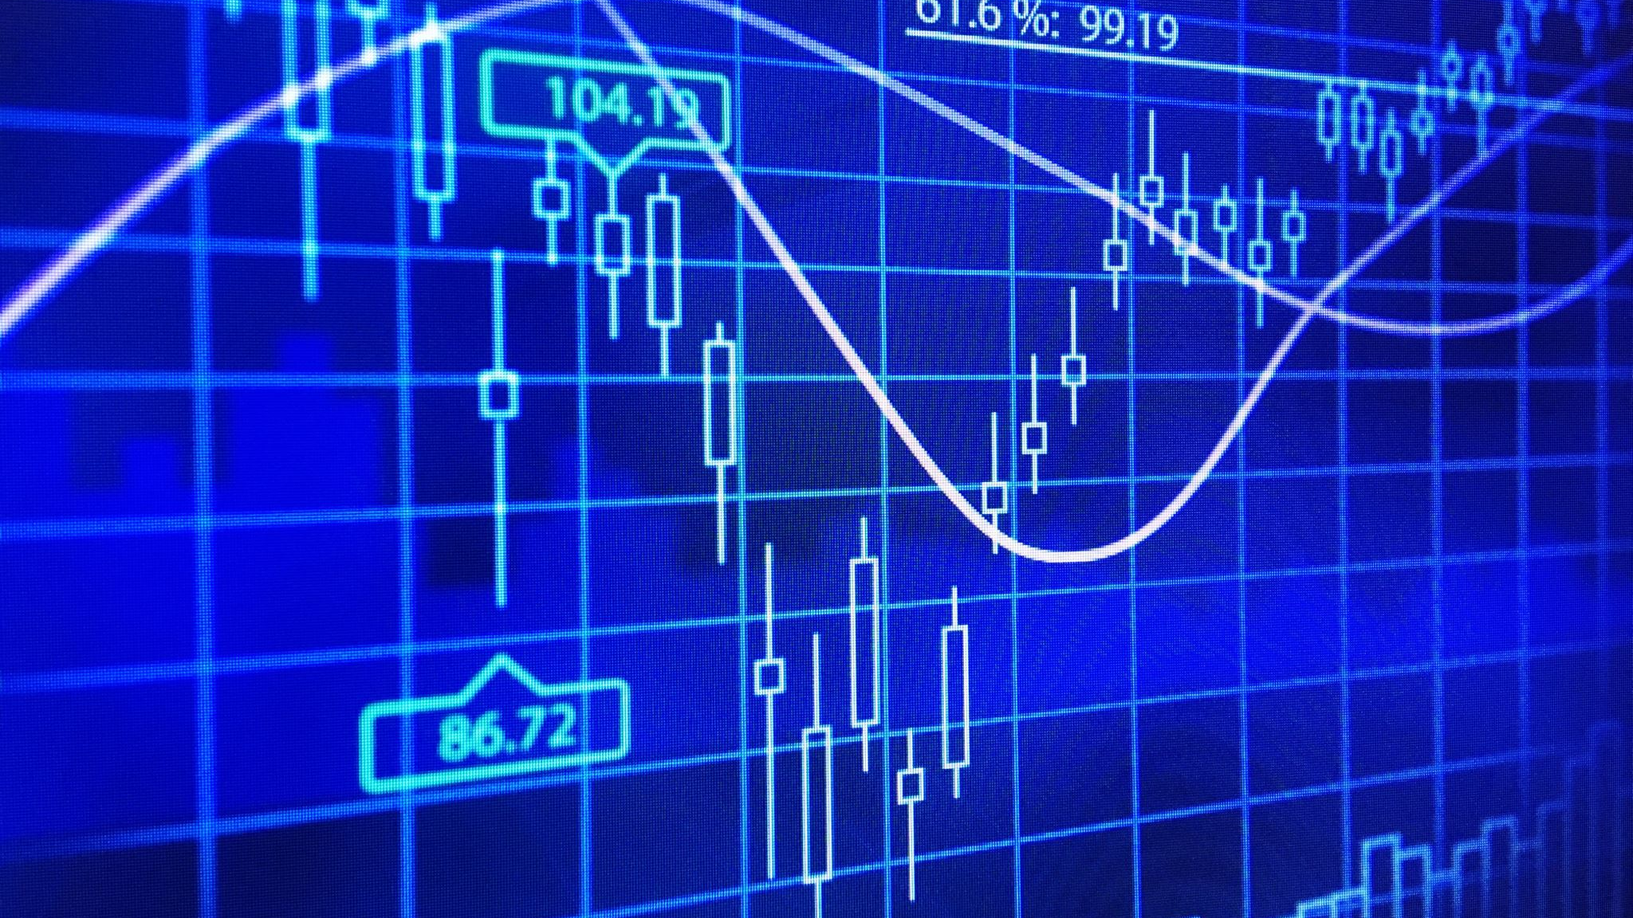
Exploratory Analysis

Slide 15
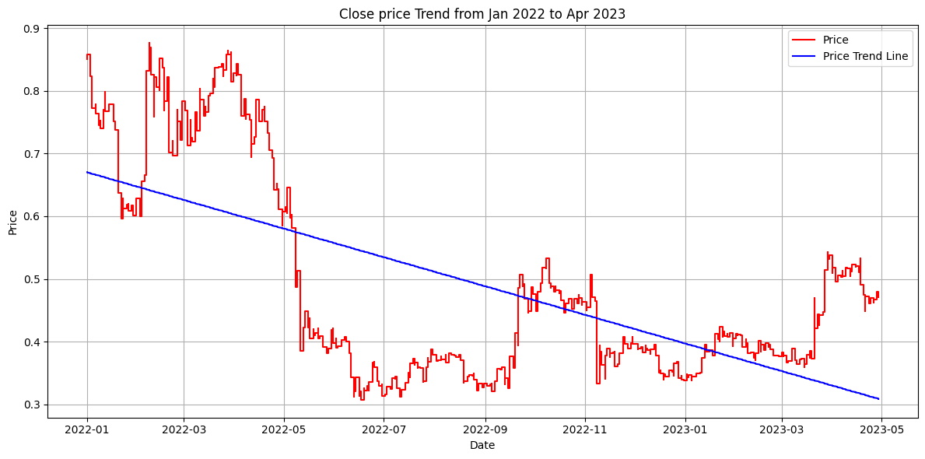
1.What is the trend in price data?
Date is on the X axis and Price is on the Y axis.
Overall, it is seen that the Price is undergoing a downward trend during the time period.

Slide 16
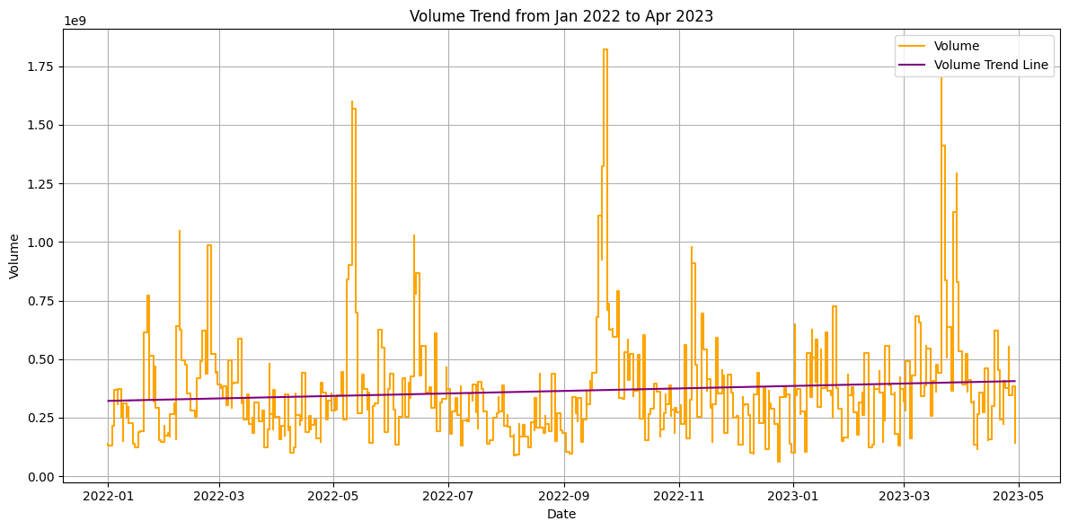
2. What is the Volume trend?
Date is in the X axis and Volume in the Y axis.
It is observed that Volume is showing an upward trend during the time period.

Slide 17
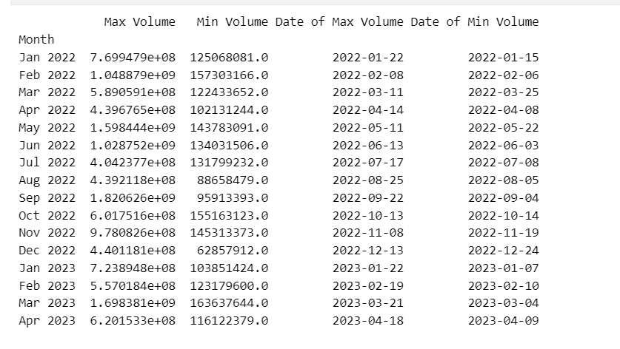
3.Are there certain days in the month where volume is higher/ lower than normal?
Higher Volumes
08-02-2022
11-05-2022
13-06-2022
22-09-2022
21-03-2023
Lower Volumes
05-08-2022
04-09-2022
24-12-2022

Slide 18
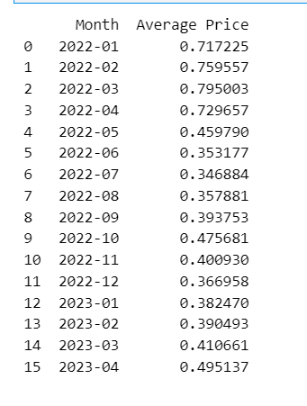
4.Are there certain months where prices are higher / lower than normal?
Normal value ranges between .35 and .5
Only higher values can be found.
Higher
January 2022
February 2022
March 2022
April 2022

Slide 19
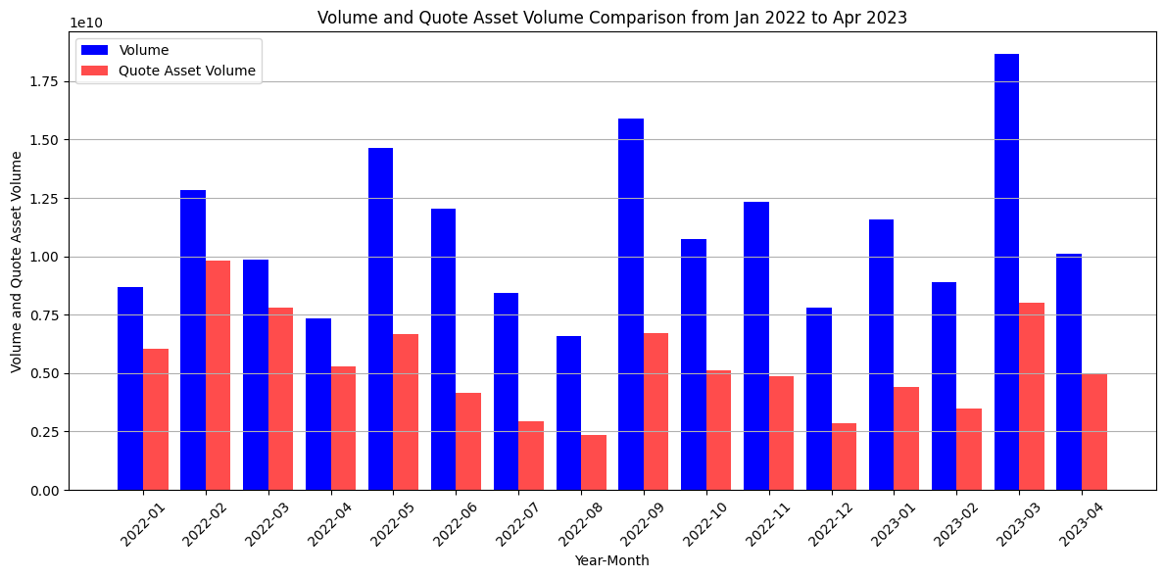
5. Is there a correlation between “Volume” and “Quote Asset Volume”?
The correlation coefficient ranges from -1 to 1
-1 :- Perfect Negative Correlation
0 :- No Correlation
1 :- Perfect Positive Correlation
Correlation Coefficient between Volume and Quote Asset Volume is 0.8680056769314456
So, Positive Correlation.

Slide 20
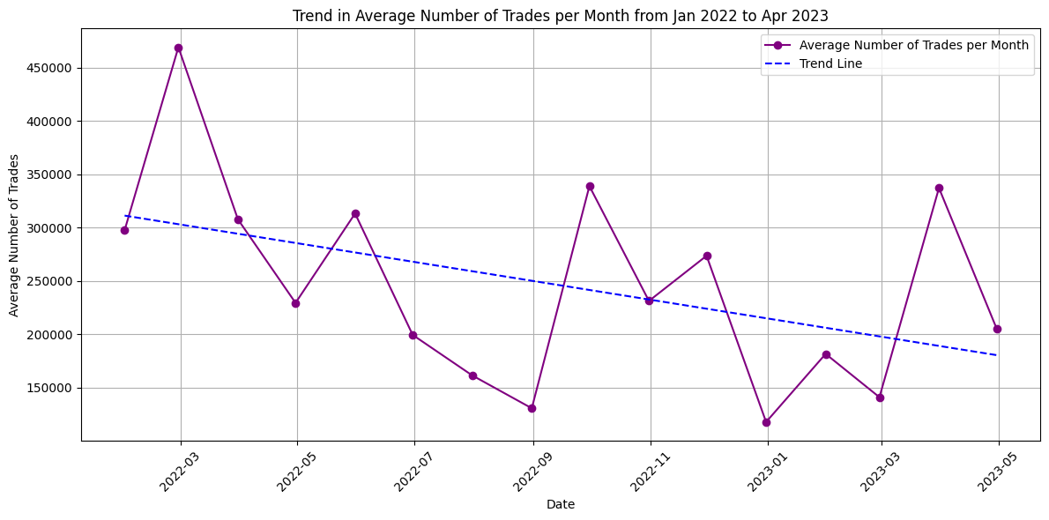
6. Is there a trend in “Number of trades”? What does it specify?
It is seen that the number of trades is having a downward trend.
Reaches peak in March 2022.
In January 2023, it reaches the lowest point.

Slide 21
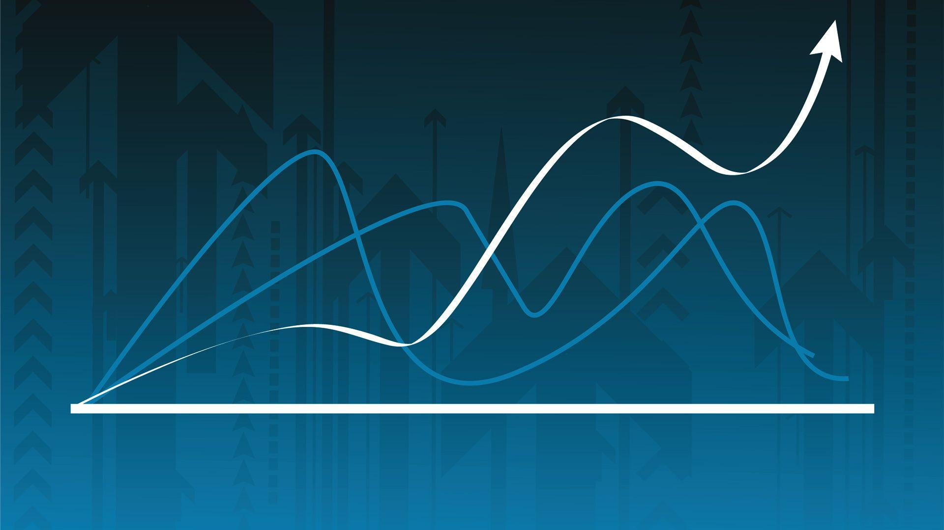
Data Visualization

Slide 22
Close price trend

Slide 23
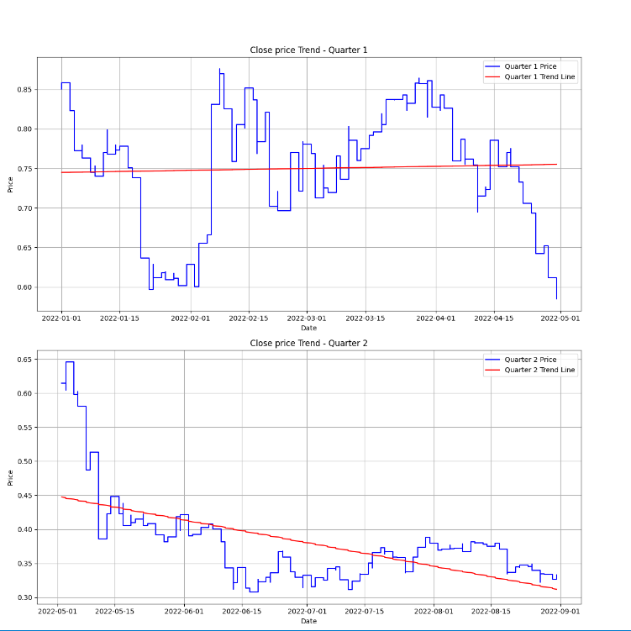
Close price trend in first 2 Quarters
In Q1 , Close Price shows a slight increase.
In Q2 , We can see decline in Close Price.

Slide 24
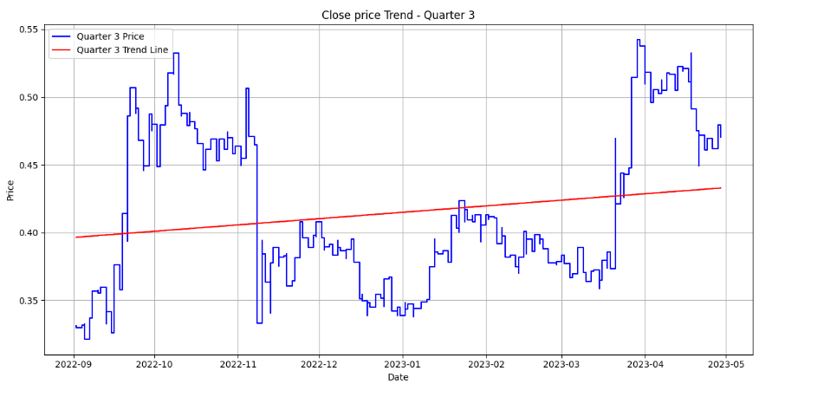
Quarter 3
In Q3, Close Price shows an increasing trend.

Slide 25
Volume trend

Slide 26
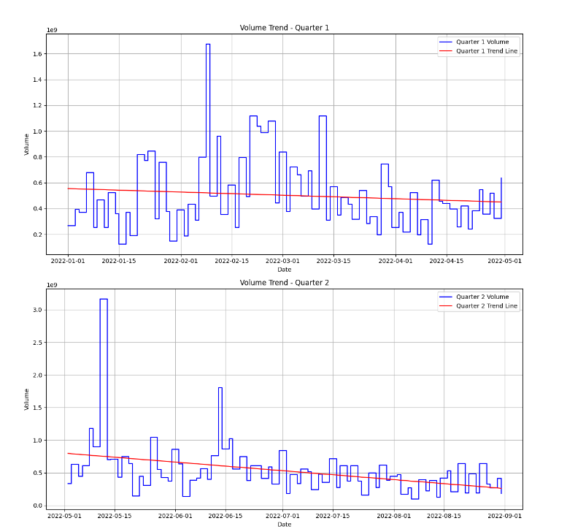
Volume trend in first 2 Quarters
In both Q1and Q2, we can that the volume is decreasing

Slide 27
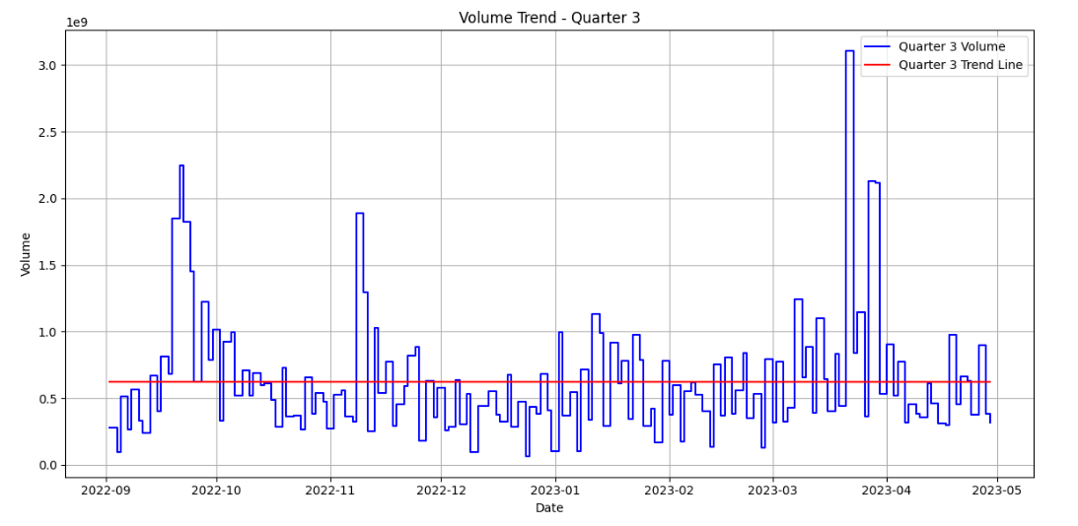
Quarter 3
The trend is almost constant in Quarter 3

Slide 28
Trend in Number of Trades

Slide 29
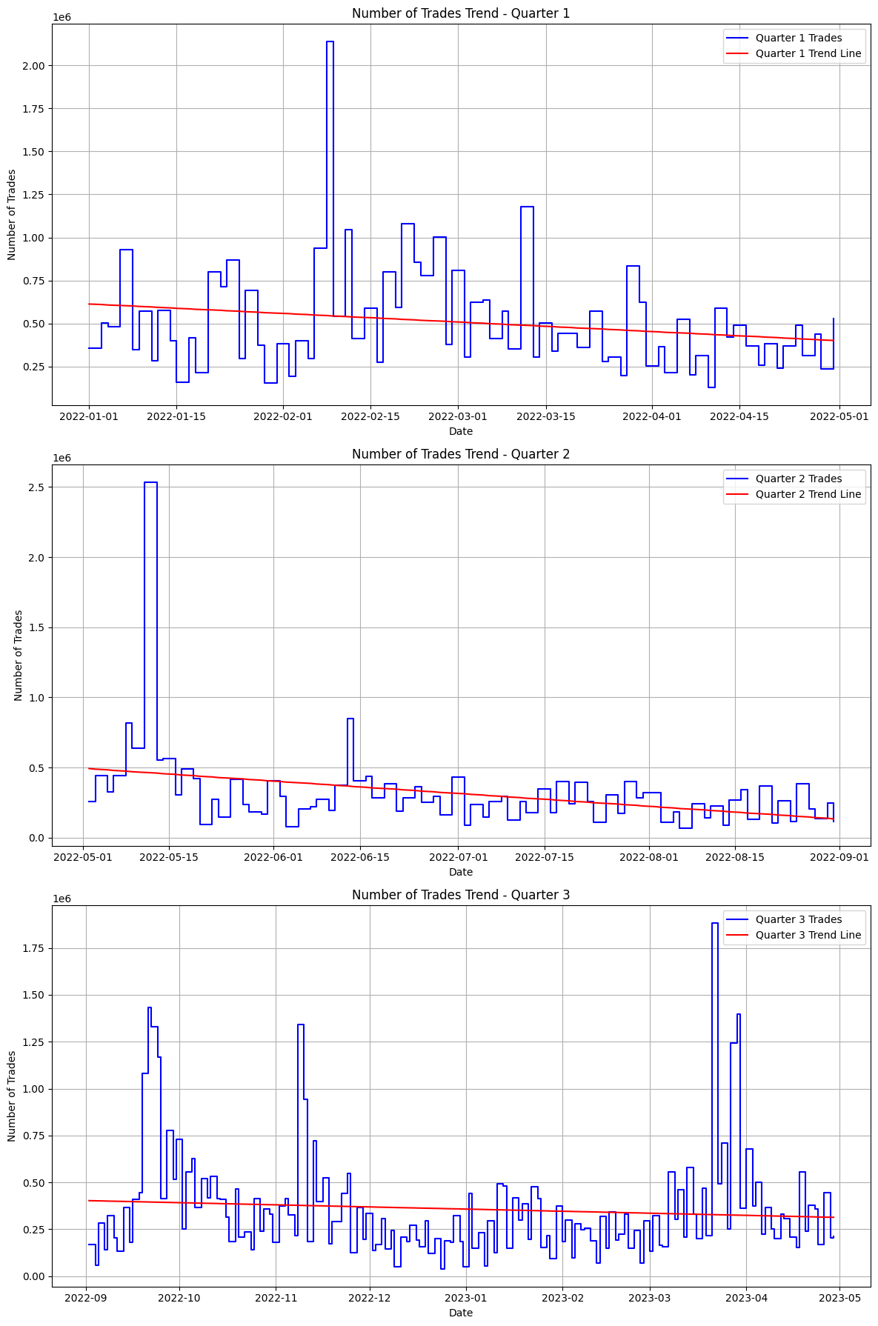
Trend in number of trades in 3 quarters

Slide 30
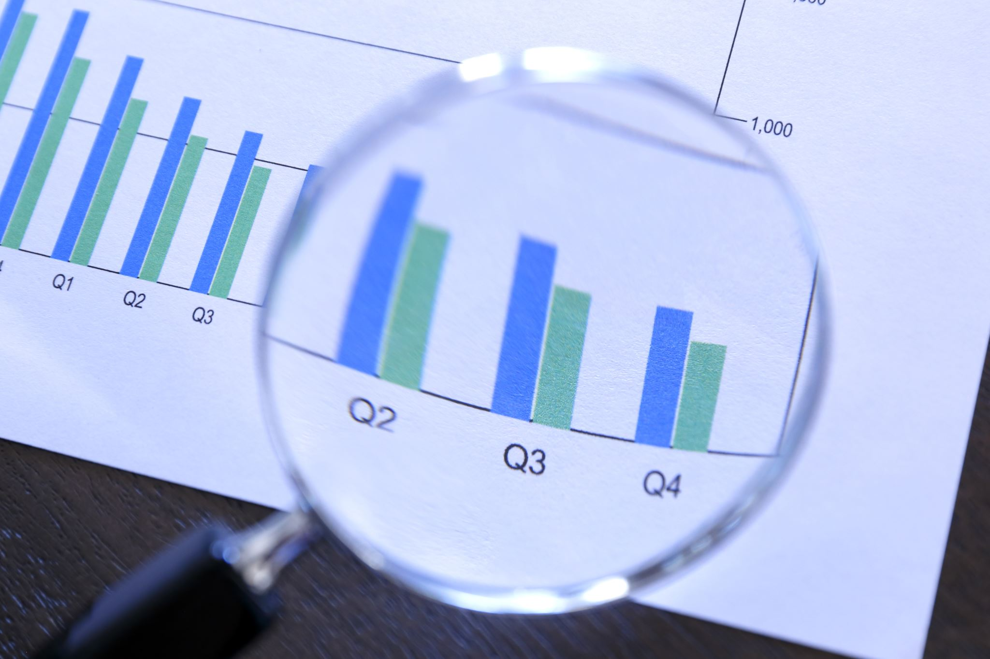
Prediction

Slide 31
Using RSI, we can predict trend reversal.
when the RSI enters extreme overbought or oversold territory, there will be a potential price

Slide 32
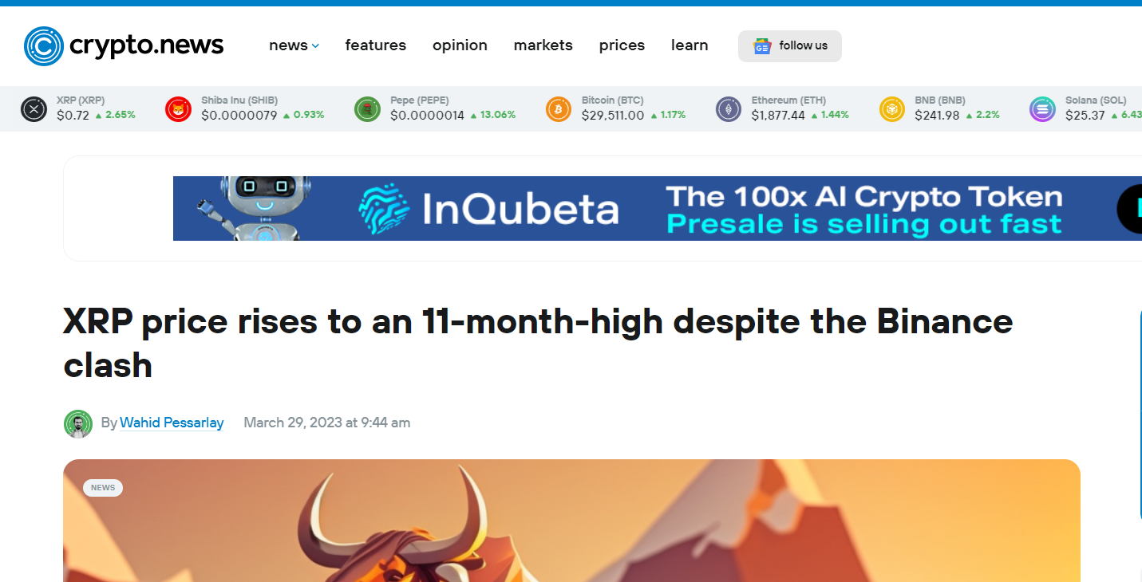

Slide 33

While the FUD around Binance getting sued by the US Commodity Futures Trading Commission (CFTC) continues to rise, the ripple (XRP) price witnessed a decent climb.
XRP’s price has reached an 11-month-high after it rose by 19% on 29th March 2023. The asset is trading at roughly $0.57. The last time XRP touched the $0.56 mark was in May 2022. Its latest bullish momentum started on March 21, but witnessed a notable drop from $0.48 to $0.41 on March 23. Most of the Ripple community expects a bullish move from the asset, according to the XRP chat on CoinMarketCap (CMC).

Slide 34
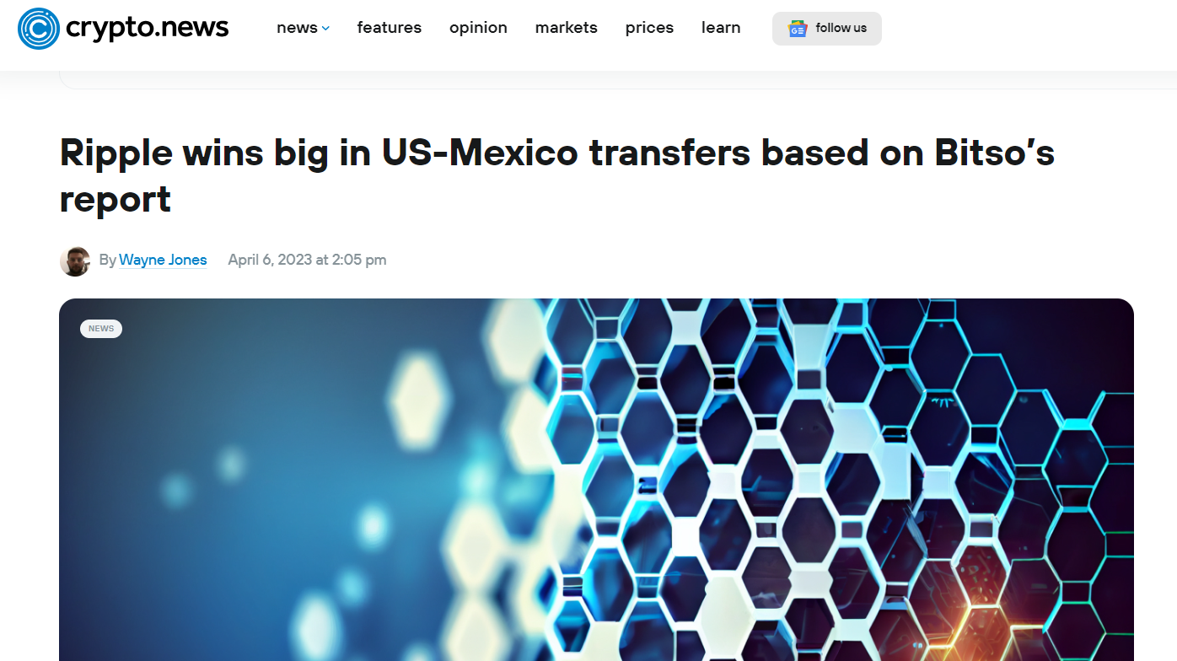

Slide 35
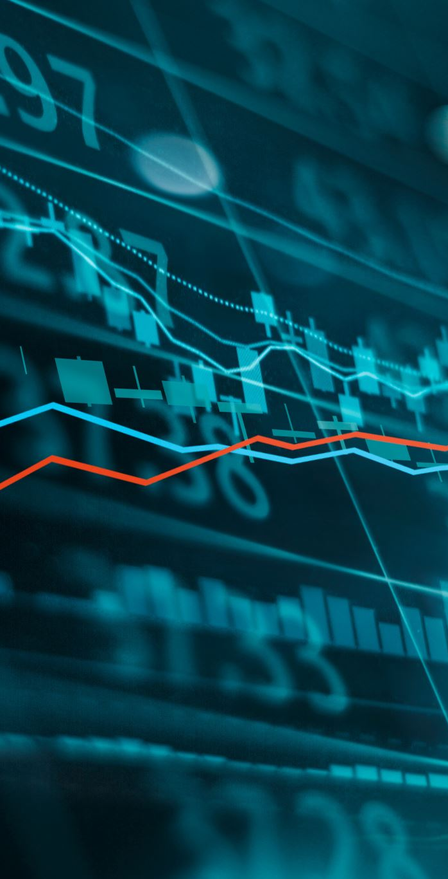
Bitso, a popular crypto exchange in Mexico, recently announced powering transactions of about $3.3 billion worth of crypto between the U.S. and Mexico. Based on Bitso’s report, the Ripple network is one of its primary settlement partners for cross-border transactions.
The crypto exchange Bitso indicated that most international transactions leverage stablecoins or XRP.
Ripple’s XRP has experienced an impressive $8.85 billion inflow in market cap within a month, bringing its total market cap to $26.93 billion.

Slide 36
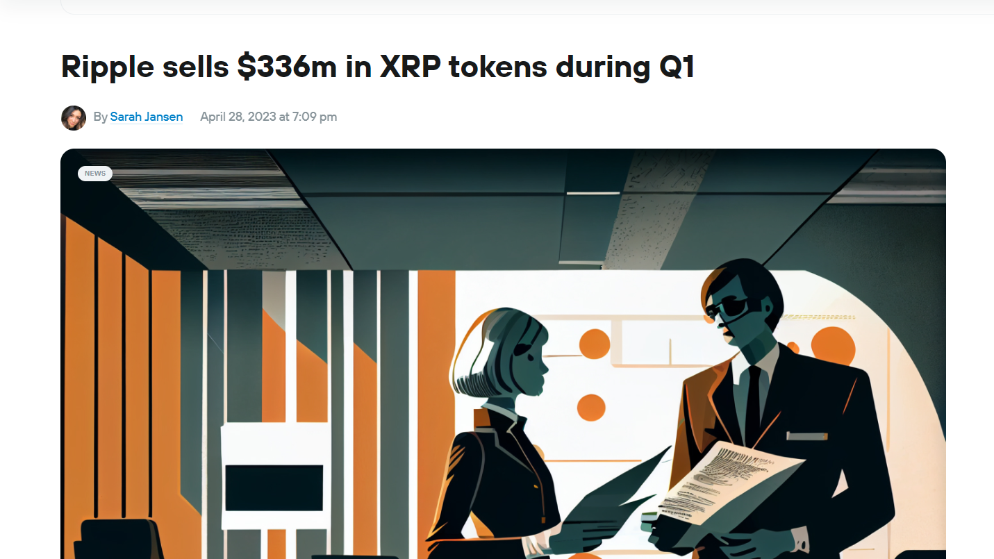

Slide 37
According to the latest XRP Markets Report, Ripple, a blockchain company developing global payment products, sold over $361 million of XRP tokens in Q1. That is from Jan 2023 to April 2023.
$361 million is a significant increase from the previous quarter, which saw sales of $226.31 million.
Despite facing headwinds during the banking crisis, Ripple's products, including the XRP Ledger and on-demand liquidity (ODL) product, have remained resilient. The disruption caused by the crisis impacted cryptocurrency liquidity, but customer flows quickly recovered, and Ripple reported strong sales through ODL
Ripple faced a brief disruption during the banking crisis, which led to a halt in XRP purchases. However, they have resumed purchasing XRP and plan to continue doing so as the adoption of their ODL product grows.

Slide 38
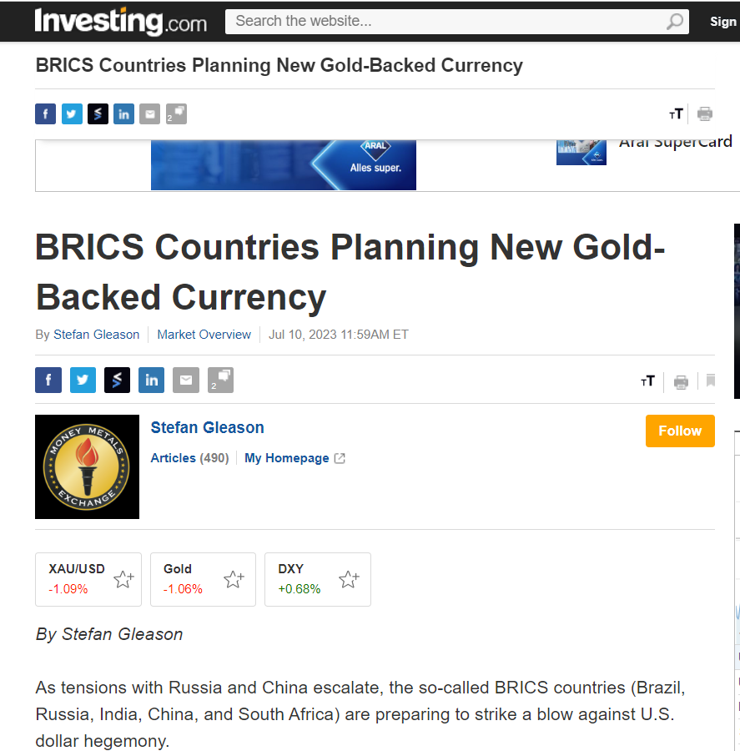
The BRICS countries are planning to introduce a new trading currency, which will be backed by gold.
Russia's announcement that the BRICS currency will be backed by gold could strengthen a bullish trend in the gold market, providing a promising short-term swing trade opportunity

Slide 39
Q1. The existing financial system that we have is archaic. If there is a reversion to the gold standard and the existing financial system collapses:
-would XRP be the new global standard, backed by silver/ gold/ precious metals, especially when it is going through a lawsuit?
Bonus: Can the same be applied to Bitcoin?
-What are the strong indicators for Ripple and its XRP Ledger growing into a global banking system?
Bonus: Also specify for bitcoin.
XRP and Bitcoin's acceptance as a global standard depends on market dynamics and circumstances, as they are decentralized cryptocurrencies with distinct characteristics and cannot be a single solution.
US SEC is suing XRP, potentially impacting regulatory status and adoption by financial institutions. XRP's on-demand liquidity product is not guaranteed global standard.
Bitcoin gains popularity as a wealth store and hedge against economic instability, primarily seen as digital gold. Its global standard depends on regulatory developments, technological advancements, and market acceptance.
Strong indicators for XRP and Bitcoin
Ripple's ODL product attracts financial institutions for quick, low-cost cross-border transactions. It has formed alliances with banks and financial service providers, signalling interest in its technology. Regulatory clarification is crucial for growth and adoption.
Bitcoin's store of value narrative attracts institutional and corporate interest as a hedge against inflation and economic uncertainty. More financial institutions and Businesses are adding it to their portfolio. Its rare supply of 21 million coins offers potential advantages as a deflationary asset.

Slide 40
Q2. What would be the major risks, exposures, and restraints within a governmental XRP/ Bitcoin Ledger banking system from the citizen’s (businesses, consumer) perspective?
Citizens and businesses using these cryptocurrencies in their day-to-day transactions may face uncertainty about the value of their holdings, as prices can fluctuate significantly in the short term.
Government adoption of XRP or Bitcoin could lead to changes in regulations and policies. Uncertain regulatory frameworks can make it difficult for businesses and consumers to understand the legal implications and compliance requirements.
The decentralized nature of cryptocurrencies can pose a security risk. Users can become the target of cyberattacks, hacks or phishing, potentially resulting in the loss of funds.
Unlike traditional banking systems, cryptocurrencies typically do not offer the same level of consumer protection, such as deposit insurance or chargeback mechanisms. This can make citizens vulnerable to fraud or litigation.
The use of cryptocurrencies as the primary means of payment may face resistance from businesses and service providers that do not accept digital currencies. This limited acceptance may hinder the widespread use of XRP/Bitcoin in day-to-day transactions.
Widespread adoption of a new banking system based on XRP or Bitcoin will require significant user training to ensure citizens understand how to use and secure their crypto holdings.
Blockchain technology, the foundation of both XRP and Bitcoin, is always evolving. Technical issues, such as network congestion or software failures, can cause delays or disruptions in transactions.

Slide 41
Q3. When do you predict a wealth transfer from the current system to a new system to be finalized? (i.e., old systems will no longer or insignificantly be in use/active)
The timing and likelihood of transferring wealth from the current financial system to a new one, where the old systems are no longer or less used, cannot be predicted directly as it depends on a multitude of complex and interrelated factors.
These factors include global economic conditions, technological advancements, regulatory developments, geopolitical events, and changes in consumer behaviour.
Major changes in the global financial landscape do not occur suddenly and often require significant time for adoption, infrastructure development, and institutional acceptance.
The financial system is complex and deeply rooted, with wide networks and dependencies around the world. Any major transformation or asset transfer requires careful planning, coordination and adaptation to ensure stability and avoid disruptive consequences.

Slide 42
Q4. Does your research indicate the emergence of a new currency, Like BRICS led or will the dollar remain?
Various countries and groups, such as the BRICS countries, to explore alternatives to the dominance of the US dollar in the financial system Global.
The BRICS countries have announced their plan to introduce a new trading currency, which will be backed by gold.
Many Countries have also started to move away from US dollar and use other currencies for trades.
But it is not possible to determine whether a new currency such as the BRICS or a significant move away from the US dollar as the world's main reserve currency will happen or the US dollar stand tall.

Slide 43
Q.5 In an upcoming recession which market sectors, industries and niches will:
newly emerge as they cater to specific consumer needs instead of wants.
- continue to grow alongside the usual consumer staples, while others decline?
Newly Emerging Sectors
Healthcare and Telemedicine:
Online Education and Skill Development
Essential Goods and Services
Market Sectors Continuing to Grow
Technology and E-commerce
Renewable Energy and Sustainability
Home Entertainment and Streaming Services
Discount Retailers
Declining Sectors:
Luxury Goods and Travel
Non-Essential Retail
Automotive

Slide 44
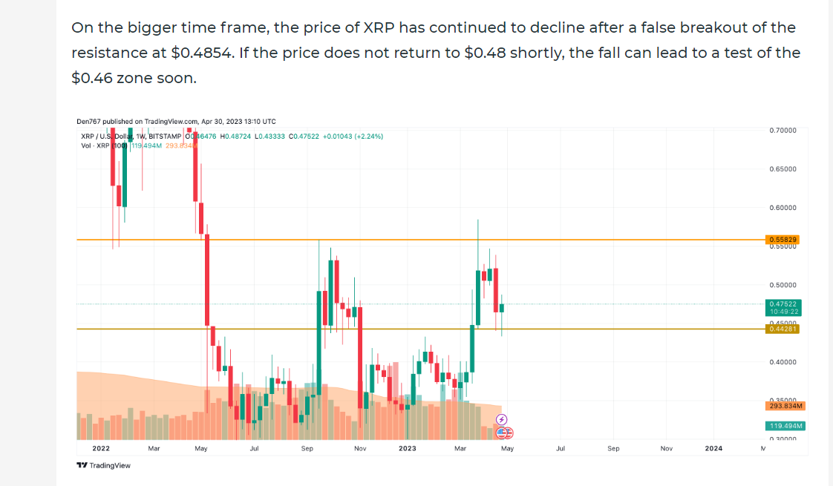
Based on the Market Research Analysis, it was observed that XRP’s price has reached an 11-month-high after it rose by 19% on 29th March 2023. The asset was trading at roughly $0.57. But by the end of April price of XRP has declined to $0.4705 after a false breakout of the resistance at $0.4854

Slide 45
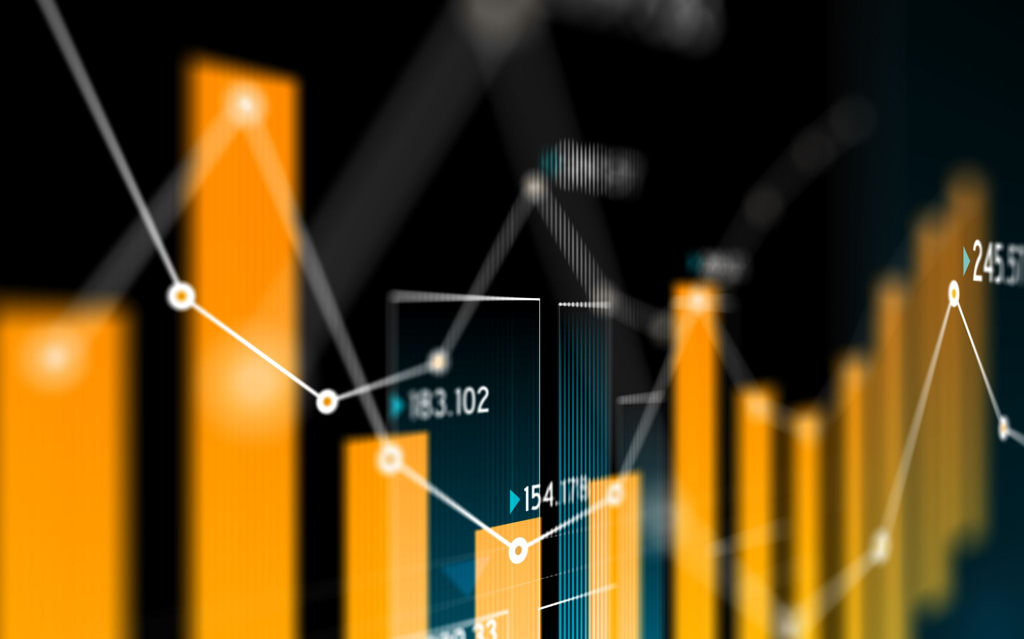
conclusion
By analyzing the Volume, Number of Trades and Closing price we can see the trends related to XRP.
Variation in trends is seen throughout the year in the quarterly analysis .
In Full year analysis the trend shows a gradual decline in the price of XRP.
This decline in prices may be due to the socio-political issues like lawsuit from the U.S. Securities and Exchange Commission (SEC), Ukraine Russia war and the inflation caused by the war.

Slide 46
Thank you

